Slide 1

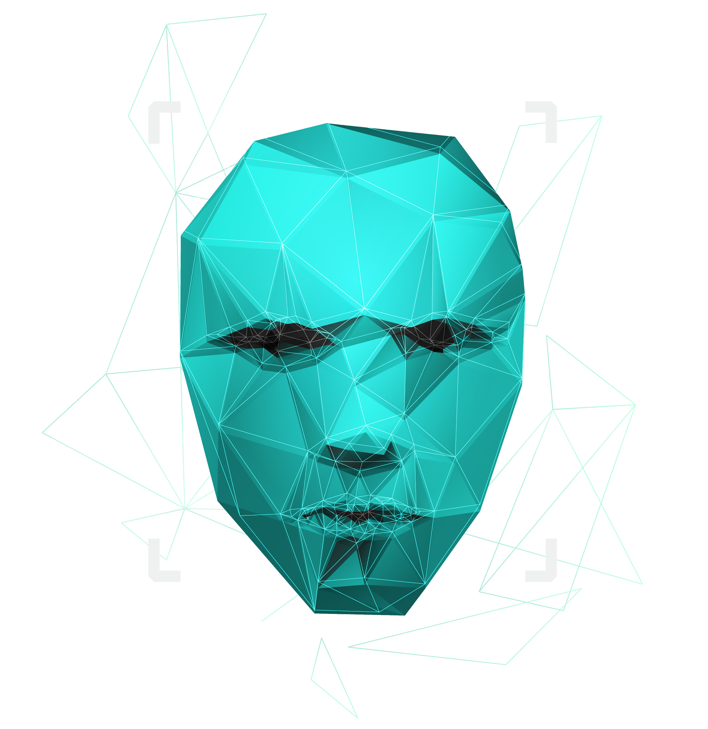
Paternity testing using genetics
Supervised by : Dr. Ashraf Abdelraouf & Eng. Ahmed Hazem

Slide 2

Agenda
Introduction
System Overview
Design Patterns
Sequence Diagrams
Use Cases
Data Design
Experimental Result
Time Plan
Live Demo

Slide 3

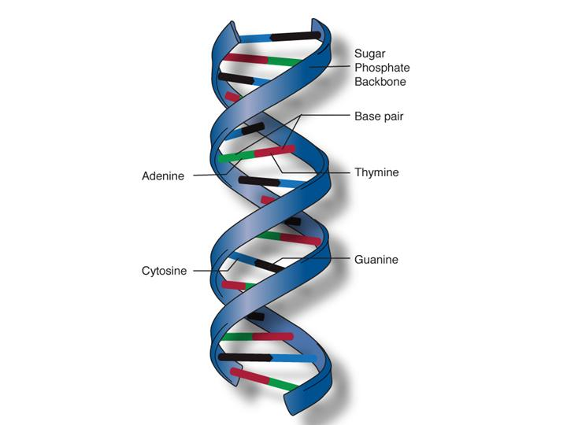
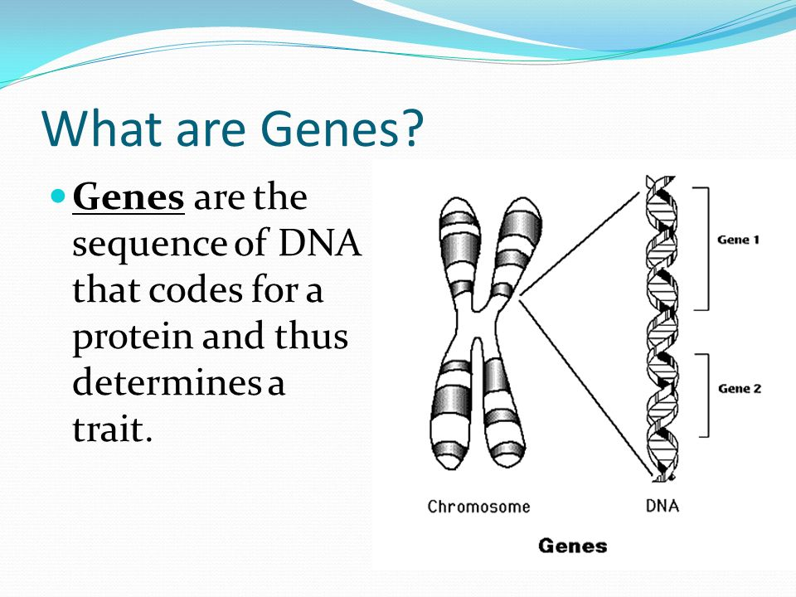
Introduction
DNA
DNA molecules allow this information to be passed from one generation to the next.
Genes →Genes are passed from parents to offspring and contain the information needed to specify traits(qualities). Genes contains a subset of the DNA and this subset is (A, T, C, G).

Slide 4
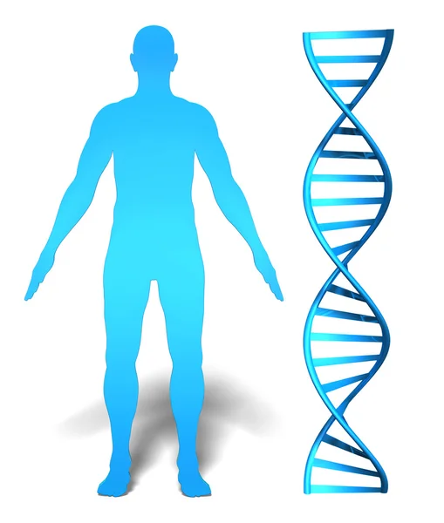
Introduction (cont.)
Whole genome
It is the whole DNA sequence that a human have in their system.
Whole exome
It is a part of the whole genome and makes up to 1.5% of it and it may reveal information about family relationships (ex: paternity test)

Slide 5
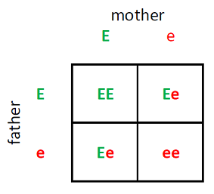
Introduction (cont.)
What is an rsNumebr?
It is a reference number to the gene we have that consists of two alleles (one from the father and the other from the mother).
EX:
RsNumber | Father | Mother | Child1 | Child2 | Child3
rs3131972 | AG | GG | AG | GG | GG

Slide 6


Problem Statement
Some parents suffer from the process of paternity testing when they are being sued for child custody.
A lot of time when a crime happens, some DNA would be left at the crime scene and would take some time to be processed and eventually lead us to the one who committed that crime.
Why can’t we have a system that could potentially prove this in less time and be accessible to everyone.

Slide 7
Our Objectives
Make an automated system to accurately prove parentage of someone by their rsNumbers and their genotypes.
Add another part to enter the user’s whole genome or whole exome.
We aim to have the application accessible by everyone by an online web application.
We aim that the user can see which alleles contributed to being wrong that led to prove wrong parentage.

Slide 8
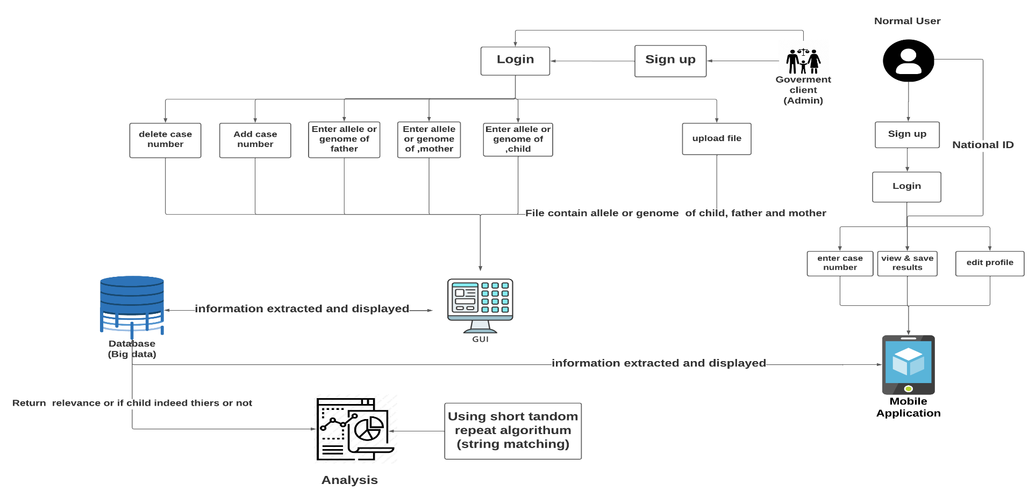
System overview

Slide 9
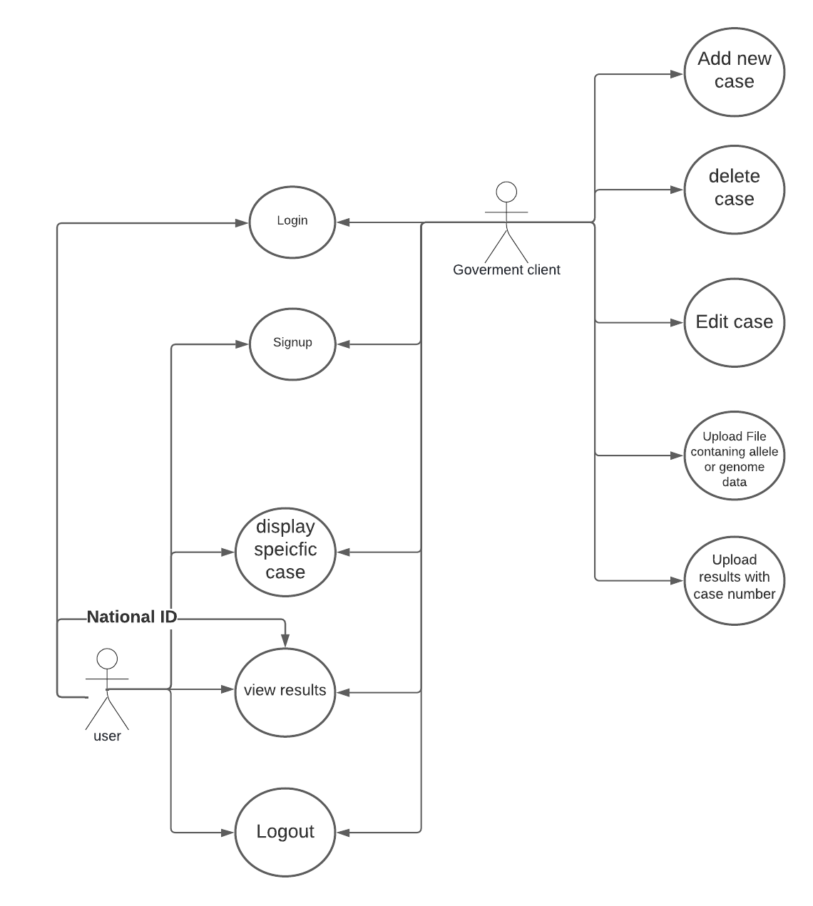
Use Case Diagram:
The system can accept files from the user containing their genotypes.
The system can save the user’s data (genotypes) (results)
The user can input their genotypes and get a report showing which genotypes contribute to the paternity test.
The user can see which alleles are different if it was proven wrong.
Rewrite this part

Slide 10
Non-Functional Requirements:
Safety: The system will detect any attacks and it should be secure
Availability: The system should be available at any time without any failure.
Scalability: our system is able to increase its capacity and functionalities based on the users demand. it can remain stable while adapting to changes and upgrades

Slide 11
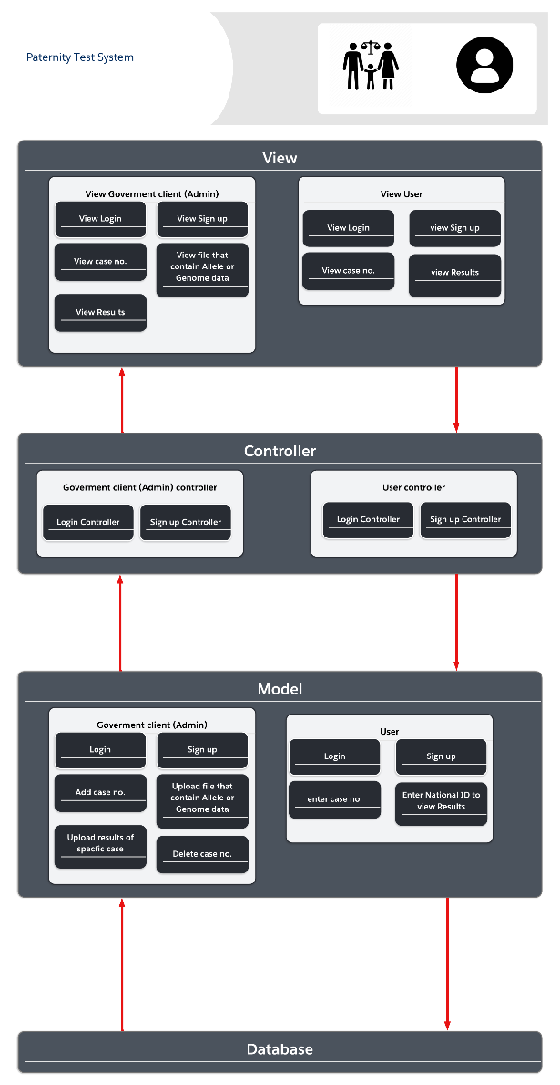
Diagrams:
- architecture diagram:
Model-View-Controller (MVC) is a design pattern that divides an application into three basic logical components: Model, View, and Controller and we aim to use it in our system.
a view is the component of the program that reflects how the results of the paternity test and report will be viewed. The data given to the system should be uploaded by the user for it to be processed and output to the user.
The application's controller is the component that manages user interaction. The controller interprets the user's mouse and keyboard inputs, causing the model and display to adapt appropriately, much like when the user interacts with the testing process and uploads its data.
Data and logic are contained in the model section. It represents data exchanged between controller components or any other business logic linked to it. Admin can obtain user information from the database using a Controller object, for example. Before sending data back to the database or displaying it, it manipulates it.

Slide 12
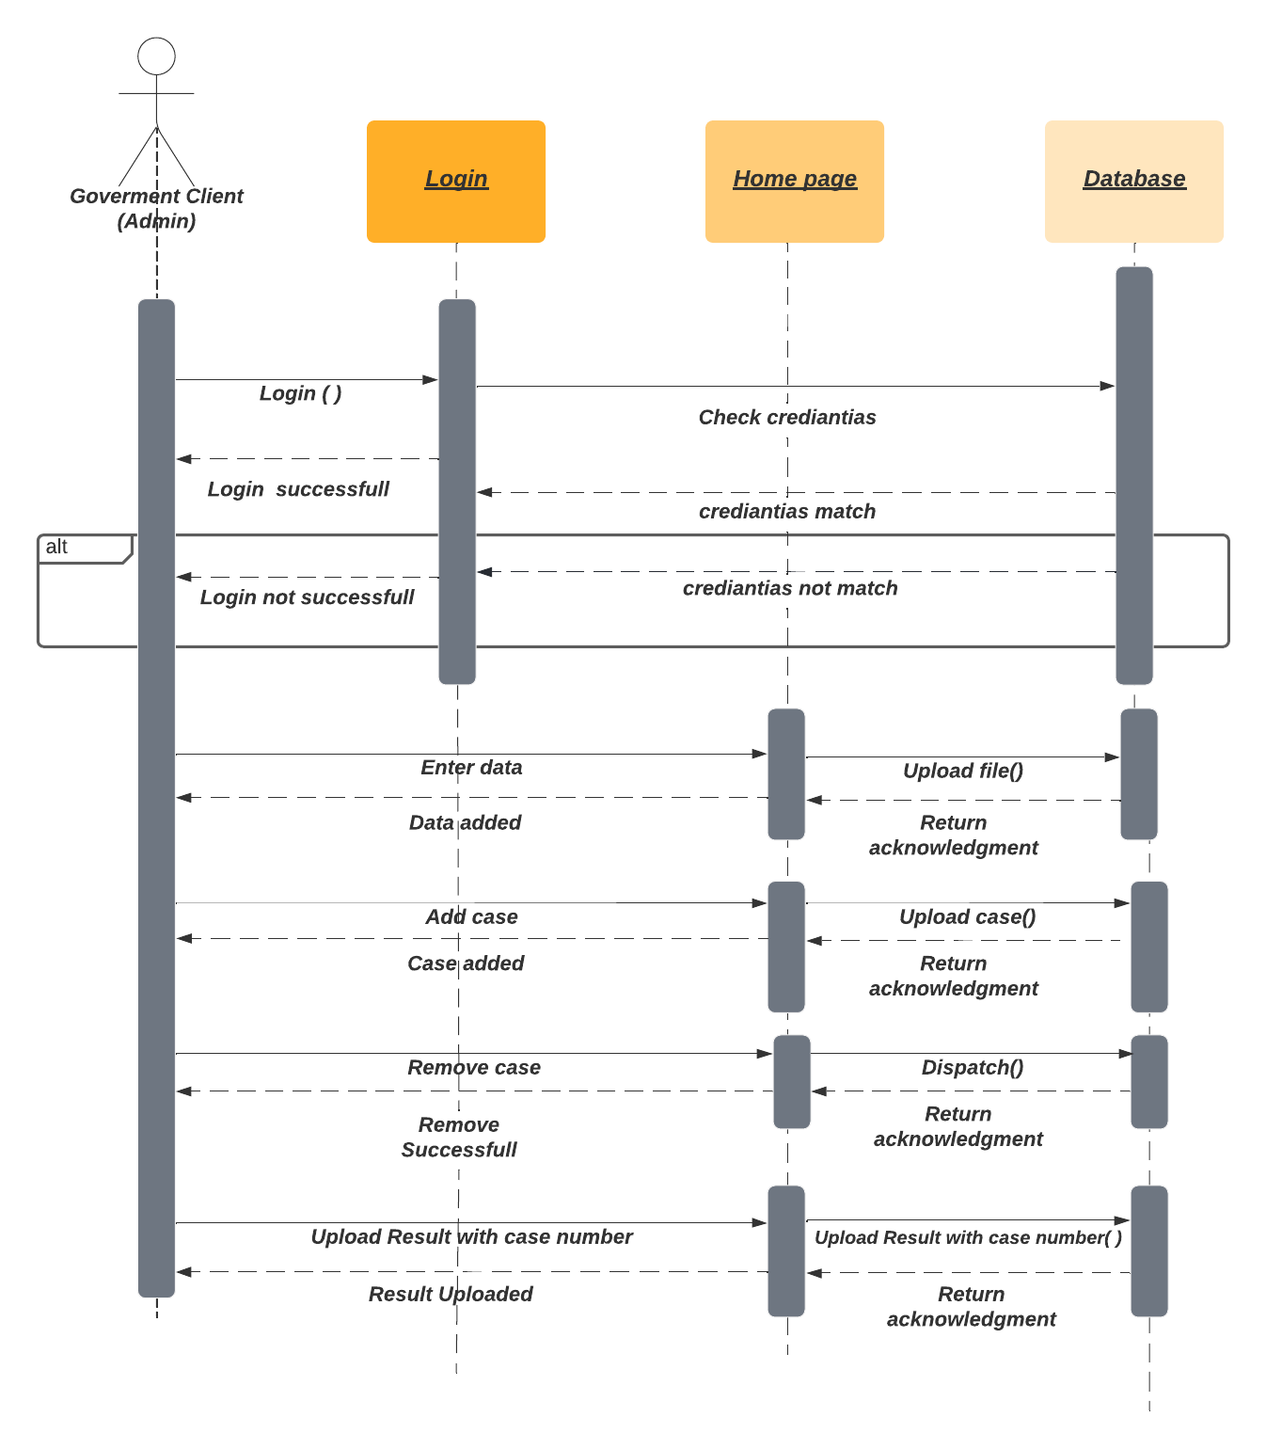
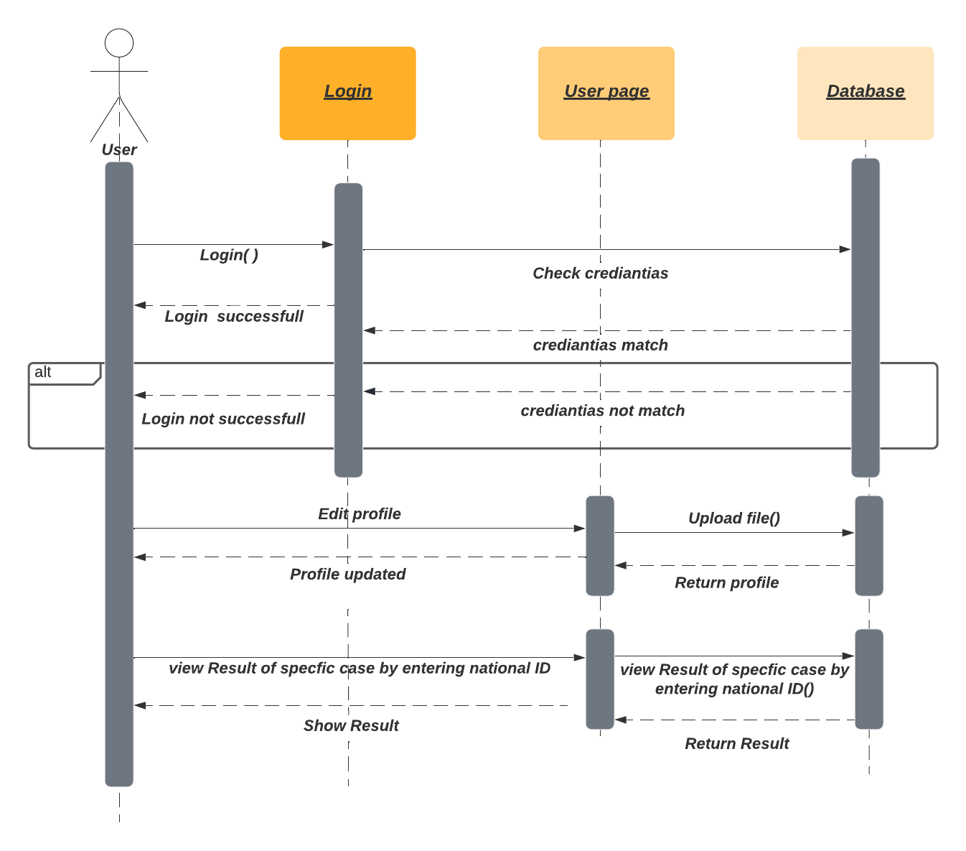
- Sequence diagram:

Slide 13
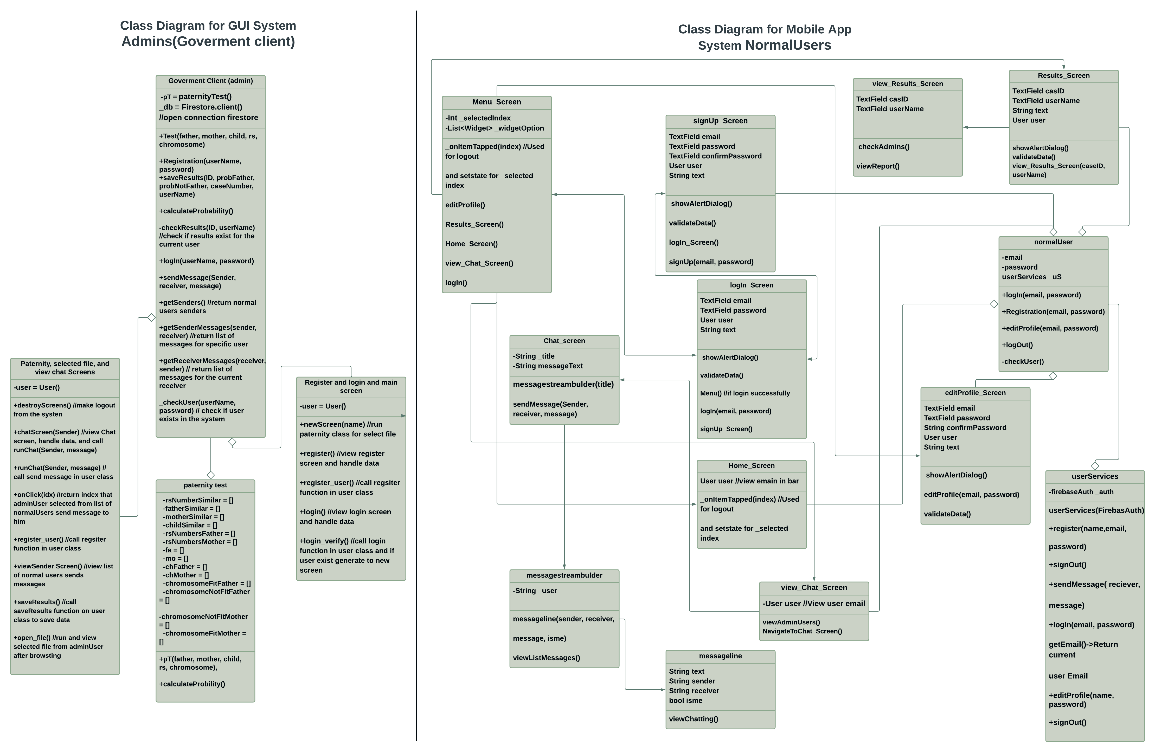
Class diagram:

Slide 14
13/1/2022
Enhance everything we implemented so far
Whole genome processing from the sources we gathered
By the end of January
TIME PLAN
Potentially add Whole exome in our system based on the information we gathered
By the end of February
Implement at least 60 % of the web application
Before the end of Februrary
Start by the end of February
Prove that if is at least a relevance or kinship degree

Slide 15
Live Demo

Slide 16
THANK You!
Do you have any questions?

